Slide 1

KALERWE
Church Hymnal 585
4 ~ Verses
20.
Mukama Lwe Lwazi Lwaffe…
~
The Lord’s Our Rock…

Slide 2

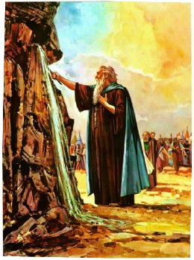
1 of 4 verses
Mukama Lwe Lwazi Lwaffe
Eri oyo gye tweyuna.
Ye atuwonya mu kabi,
Ye kye kiddukiro kyaffe.

Slide 3
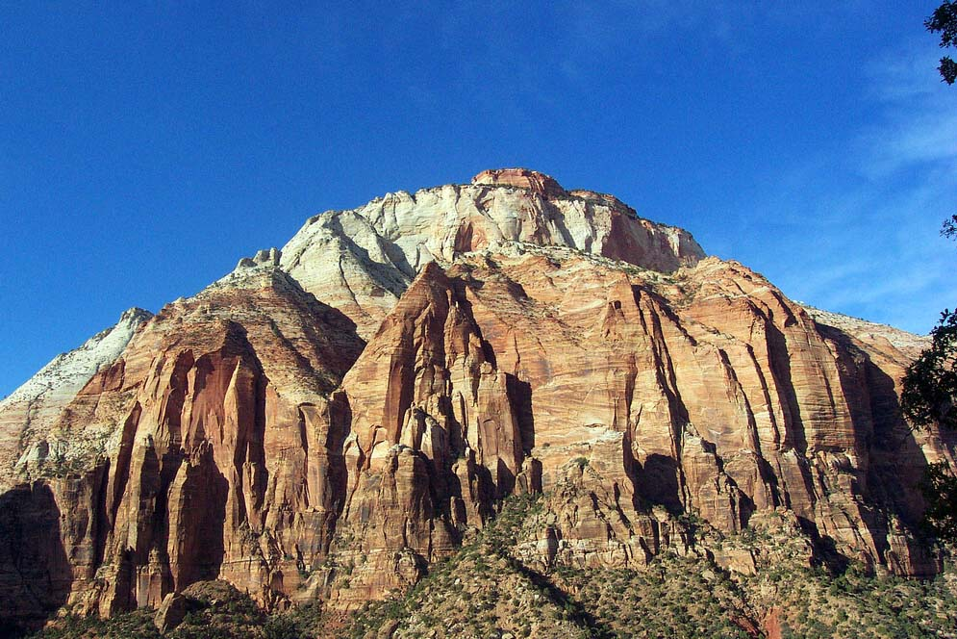
1 of 4 verses
CHORUS:
Ggwe olwa-zi
olw’amaanyi
Obwekwe-ko
bw’abanaku
Omusaa-le w’abayise
Ekiddukiro
mu nnaku.

Slide 4
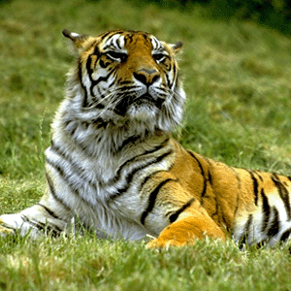
2 of 4 verses
Ye atuwonya mu byonna
Eri oyo gye tweyuna
Tetutya ntiisa ya mubi
Ye kye kiddukiro kyaffe.

Slide 5
2 of 4 verses
CHORUS:
Ggwe olwa-zi
olw’amaanyi
Obwekwe-ko
bw’abanaku
Omusaa-le w’abayise
Ekiddukiro
mu nnaku.

Slide 6
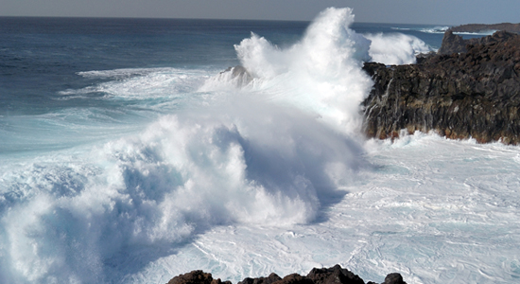
3 of 4 verses
Ennaku bwe zitujjira
Eri oyo gye tweyuna
Mwe muli eddembe lyaffe
Ye kye kiddukiro kyaffe.

Slide 7
3 of 4 verses
CHORUS:
Ggwe olwa-zi
olw’amaanyi
Obwekwe-ko
bw’abanaku
Omusaa-le w’abayise
Ekiddukiro
mu nnaku.

Slide 8
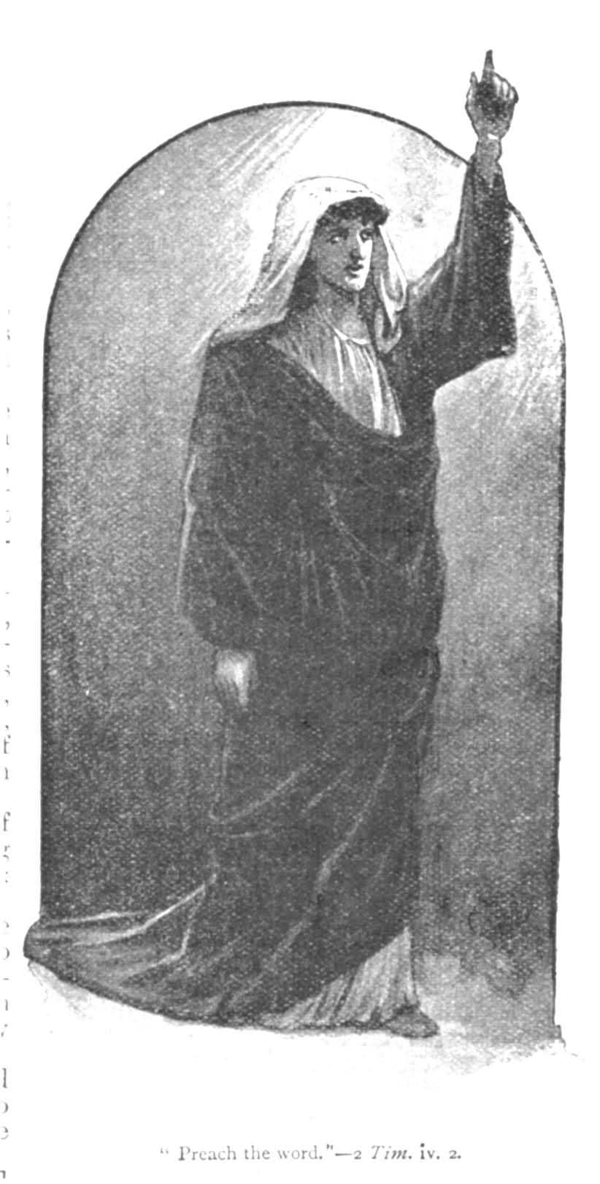
4 of 4 verses
Gw(e) olwazi lw’abantu bonna
Eri Ggwe gye tuddukira
Otuyambenga bulijjo,
Beera kiddukiro kyaffe.

Slide 9
4 of 4 verses
CHORUS:
Ggwe olwa-zi
olw’amaanyi
Obwekwe-ko
bw’abanaku
Omusaa-le w’abayise
Ekiddukiro
mu nnaku.

